Slide 1
Computing Project
Topic 1:
Introduction
Notes:
NCC Education - Title Master

Slide 2
Scope and Coverage
This topic will cover:
  Appropriate artefacts
  Planning your project
  Appropriate development methods
  Appropriate risk management
  Appropriate configuration management
Notes:
NCC Education - Slide Master

Slide 3
Learning Outcomes
By the end of this topic, students will be able to:
  Project manage the analysis, design, development and deployment of a computing artefact.

Slide 4
Key Points
  The content of this lecture is not meant to replicate or replace concepts and techniques introduced in other modules associated with this programme.
  It is meant to complement concepts and techniques introduced in other modules associated with this programme.
  This lecture should help YOU decide how YOU want to carry out YOUR project and justify YOUR decision.

Slide 5
Appropriate Artefacts

Slide 6
What is an Artefact?
  Something that you produce during the course of your project. This could include:
    Models
      Use Case diagrams
      Class diagrams
      Sequence diagrams
    Code (the programmes that you write)
    The Working System
    Supporting Documentation (test scripts, Gantt charts, user guides, etc.)

Slide 7
Artefacts for Your Project - 1
  Models
    YOU must justify why you have chosen a particular type of model for YOUR project.
  Code
    What language are YOU going to use to code YOUR project (Java, PHP, MySQL, etc.)?
    YOU must justify why you have chosen a particular language to code YOUR project.

Slide 8
Artefacts for Your Project - 2
  The Working System
    Is YOUR project going to develop a website, a database system, or something else?
    YOU must justify why YOU are going to develop a particular type of system for YOUR project.
  Supporting Documentation
    What documentation will support YOUR project?
    Future lectures will help with the definition of this particular set of artefacts.

Slide 9
Planning Your Project

Slide 10
Defining YOUR project
  Aims
  Objectives

Slide 11
Aims - 1
  The aims of YOUR project are associated with things that YOU are going to:
    Design
    Develop
    Evaluate
    Investigate

Slide 12
Aims - 2
  Typical aims for a student project are:
    To develop a database system to achieve something
    To develop a web-based system to achieve something
    To investigate the use of a particular tool or technique in a particular project environment

Slide 13
Objectives - 1
  Objectives are things that you need complete in order to achieve the aim(s) of YOUR project.
  If the aim of YOUR project is to develop a database system for a telephone company – your objectives might be:
    Complete a literature search about existing database systems for telephone companies.
    Gather user requirements.

Slide 14
Objectives - 2
    Develop a model of the database system for YOUR project.
    Code the model to produce a working system.
    Test the working system.
    Deploy the working system.
    Write YOUR report.

Slide 15
SMART Objectives - 1
  YOUR objectives should be SMART:
  Specific
    Provide enough detail to understand what should be done.
  Measurable
    Provide enough detail to measure progress of the objective and know when it is complete.

Slide 16
SMART Objectives - 2
  Appropriate
    With respect to the aim(s) of the project
  Realistic
    Achievable within the duration of the project
  Time-related
    Provide a statement of how long the objective will take and by when should it be completed.

Slide 17
Planning YOUR Project - 1
  Work Breakdown
    Produce a model that shows the tasks that must be done in order to complete the project.
  Time Estimates
    Produce estimates of the time required to complete the tasks.
  Milestones
    Significant points in your project that can be used to give an indication of how well the project is going

Slide 18
Planning YOUR Project - 2
  Activities
    Identify the order in which tasks must be completed.
  Present YOUR Plan
    Use the tasks, time estimates, milestones and activities to produce a plan, normally in the form of a Gantt chart.
  Re-plan (if required)
    Sometimes things go wrong – you may need to re-plan YOUR project.

Slide 19
Appropriate Development Methods

Slide 20
Different Methods
  You have been introduced to several different software development methods throughout this course:
    Agile
    Object-oriented
  Both of the above methods are appropriate for student projects; however, they both have their strengths and weaknesses for various types of projects.

Slide 21
Agile
  An all round method that can be used for most student projects:
    Can be used with object-oriented techniques
    Good for database development and website development
    Clearly defined project management approach
    Not good for developing real-time systems

Slide 22
Object-Oriented
  A method that can be used for most student projects:
    UML notation can be used to model database systems.
    Good for database development, website development and the development of real-time systems

Slide 23
The Method for YOUR Project
  YOU are responsible for choosing the method:
    Choose the project
    Choose the method
    Choose the language
  Make sure the method fits the project and the language fits the method.

Slide 24
Appropriate Risk Management

Slide 25
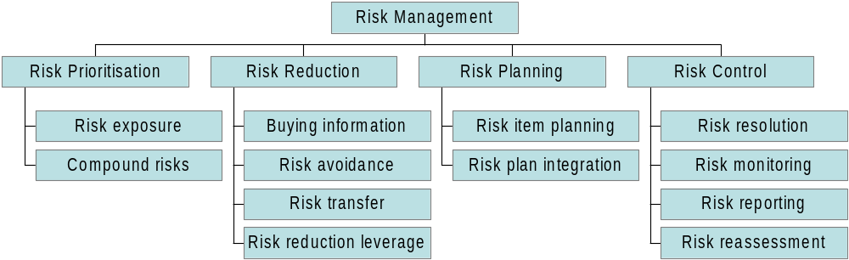
What is Risk Management?

Slide 26
Relax!
You are not required to follow everything on the previous slide for your student project!

Slide 27
Risk Management for Student Projects
  REMINDER – You are not required to use this approach. It is presented to give you an idea of the level of detail with which you need to approach risk in your project!
  Risk Management Approach
    Identify Key Stakeholders
    Identify Critical Success Factors
    Isolate the Baseline Plan
    Analyse and Assign Risks

Slide 28
Identify Key Stakeholders
  Many people want many things from a software development project.
  Identify the key stakeholders: the people whose wants count.

Slide 29
Identify Critical Success Factors
  Ask the key stakeholders what they require for success.
  The answers are the critical success factors of the project and are used to measure the success of the project.
  A risk is something that could prevent one or more of the critical success factors being met.

Slide 30
Isolate the Baseline Plan
  Risks must be associated with a plan before they can be handled.
  As risks could prevent the achievement of objectives, plans for achieving the objectives must be in place before risks can be considered.

Slide 31
Analyse and Assign Risks
  Identify
    What are the potential risks?
  Assess
    What is the likelihood of the risk occurring?
    What is the impact of the risk?
    What containment and/or contingency is appropriate?
  Allocate
    To whom can I assign the risk? (very likely to be you)

Slide 32
Containment vs. Contingency
  Containment
    Action taken before the risk occurs
    Might prevent the risk from occurring
    Should reduce the impact if the risk occurs
  Contingency
    Plan of action made before the risk occurs
    Alternative plan triggered by the risk occurring

Slide 33
Major Sources of Risk
  Contractual/Environmental
  Management/Process
  Personnel
  Technical

Slide 34
Contractual/Environmental
  There are many factors that cause this type of risk. The one most relevant to a student project is:
    An unreasonable customer

Slide 35
Management/Process
  There are many factors that cause this type of risk. Those most relevant to a student project are:
    Inadequate control of development products
    Problems and errors detected late
    Inadequate technical approaches

Slide 36
Personnel
  This type of risk is to do with people:
    Wrong grade
    Wrong training
    Wrong expertise
    Too many people
    Too few people
  The above risks are not likely to occur on your project as YOU are the only team member and you have been educated on this NCC Education programme.

Slide 37
Technical
  Requirement Changes
    Genuine changes of mind by the customer
    Hidden implications within requirements
  Failure to Meet Requirement
    Cannot produce a feasible design
    Acceptance test fails
  Problem or Error Detected
    Inconsistent design
    Missing component
    Inadequate time for testing

Slide 38
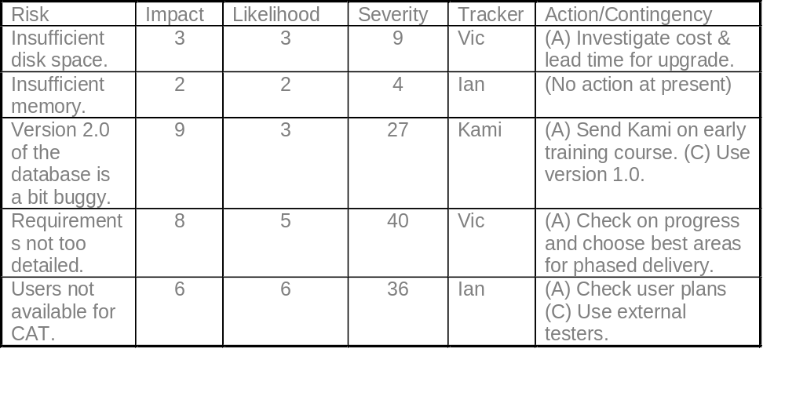
How Display Risks

Slide 39
Appropriate Configuration Management

Slide 40
What is Configuration Management? - 1
  Common problems in software development projects are in the co-ordination and control associated with project artefacts.
  Configuration management, for large projects, is facilitated by the use of expensive software to enable the following:
    The building of different systems to meet the requirements of different users

Slide 41
What is Configuration Management? - 2
    The preservation of old versions of the system, e.g. to investigate a fault
    The building of a version of the system that contains certain fixes but not others
    To allow two or more developers to work on the same artefact at the same time
    To store artefacts efficiently

Slide 42
The Good News
  YOU are not required to use a complex and expensive configuration management system for your student project.
  A simple directory structure will be appropriate.

Slide 43
Simple Directory Structure
  A simple directory structure along with supportive documentation is included in Exercise 1 in your Student Guide.
  The purpose of Exercise 1 is to:
    Show you the type of directory structure that is appropriate for a student project
    Show you the level of supportive narrative required in a student project
    Give you an opportunity to develop your own directory structure and supportive narrative
  WARNING – do not copy the directory structure and supportive narrative into your project; however, you can tailor it to support the needs of your project.

Slide 44
Computing Project – Introduction
Any Questions?
Notes:
NCC Education - End Slide Master

